Slide 1
Pyrexia Of Unknown Origin
Amrish Sukumaran

Slide 2
DEFINITION
By Petersdorf & Beeson 1961
New criteria
  Fever >38.3 C (101 F) x 2 Occasions
  Duration > 3 weeks
  No immuno-compramised state
  No diagnosis even after
    History
    Examination
    Investigations
      CBC, RFT, LFT, Inflammatory Markers, Auto-immune work up
      Urine R/E, C/S, Blood C/S x 3
      Imaging – CXR, USG
      TB – TST/ IGRA

Slide 3
Types of FUO
By Durack and Street
4 Categories
  Classical FUO
  Nosocomial FUO
  Neutropenic FUO
  HIV associated FUO

Slide 4
CLASSICAL FUO
Same definition
Causes
  Infections – 53% - TB, abscess, Bacterial Endocarditis, Leishmaniasis
  Neoplasm – 17% - NHL, HL, Leukemia
  Auto-immune – 11% - SLE, MCTD, Takayasu’s

Slide 5
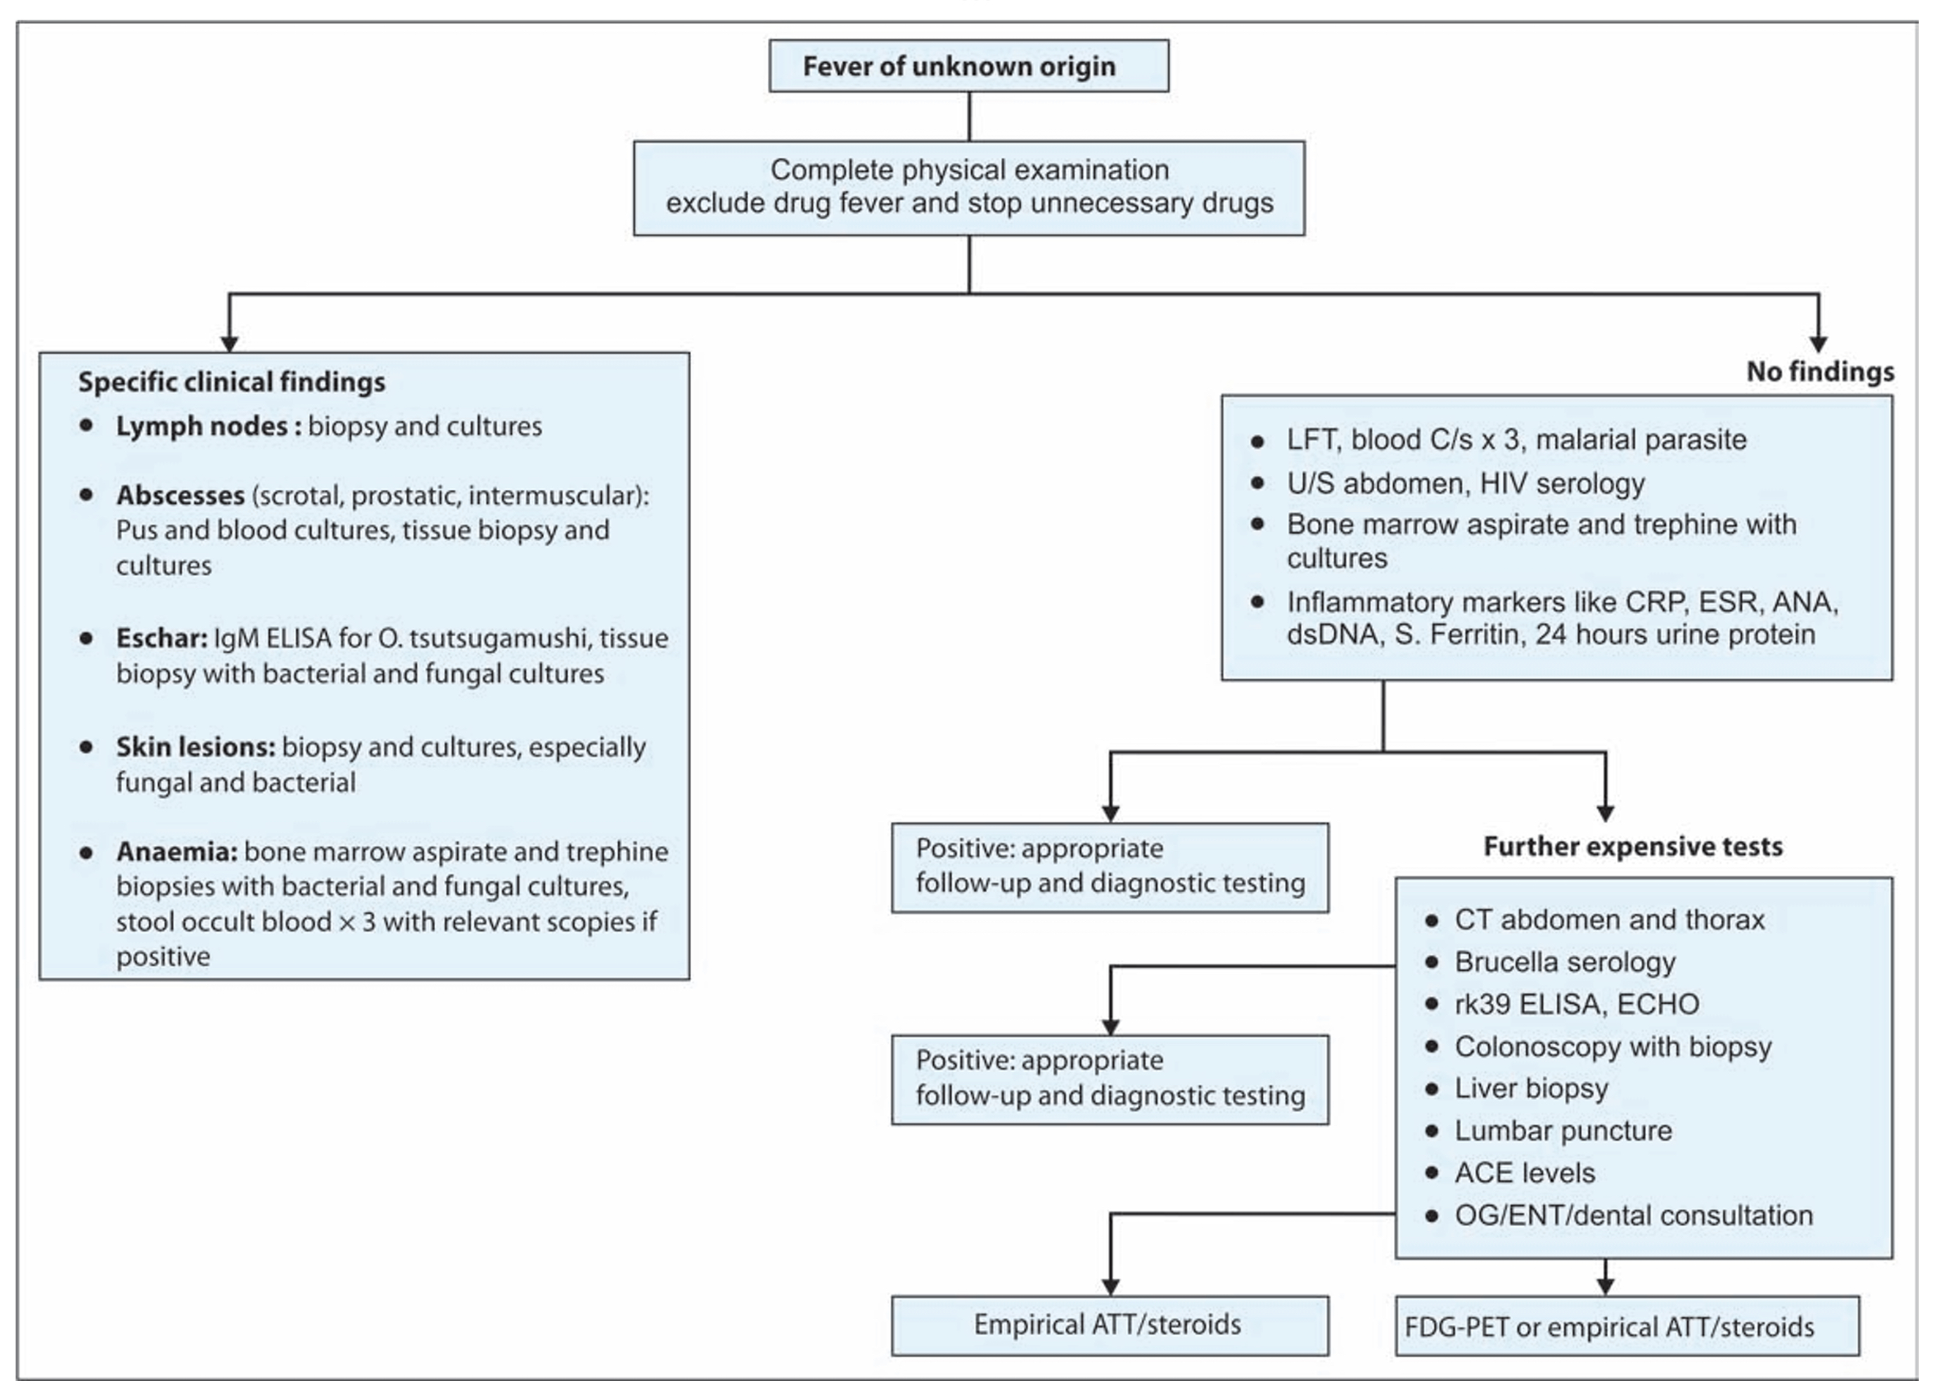

Slide 6
Nosocomial FUO
Same Definition + Hospitalised Pt + Duration – 3days
Causes
  Post Op - Abscess, Hematoma, FB
  Infected prosthesis or catheter
  Clostridium Difficile colitis, Acalculous cholecystitis
  DVT, Pul. Embolism, Drug Fever

Slide 7
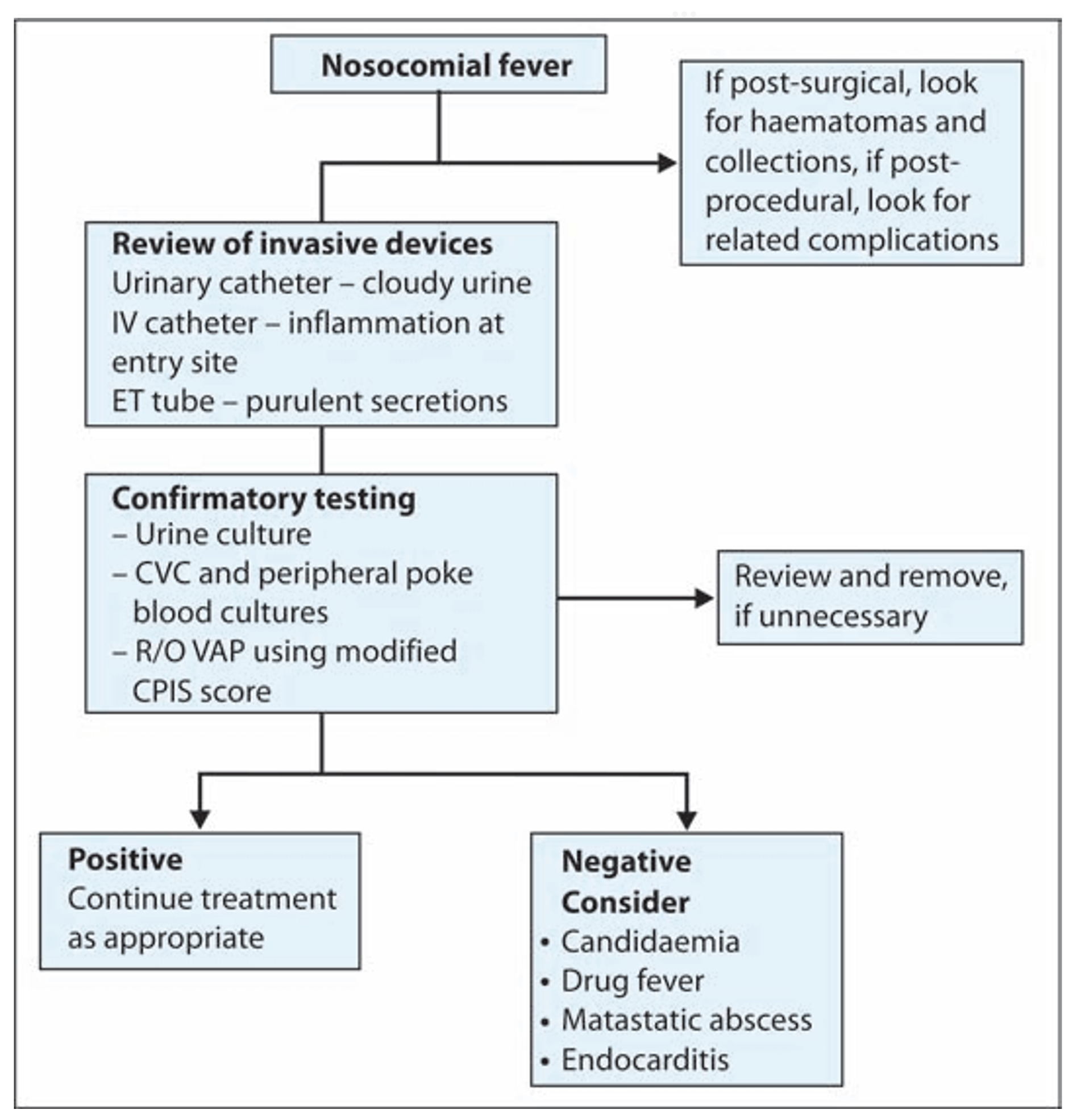

Slide 8
NEUTROPENIC FUO
Same definition + ANC < 500
Causes
  Invasive Fungal Infections – Pneumonia, Sinusitis, Dental Abscess
  Bacterial – E. Coli, Klebsiella, Pseudomonas, S. aureus, CONS
  Viral – CMV, HSV

Slide 9
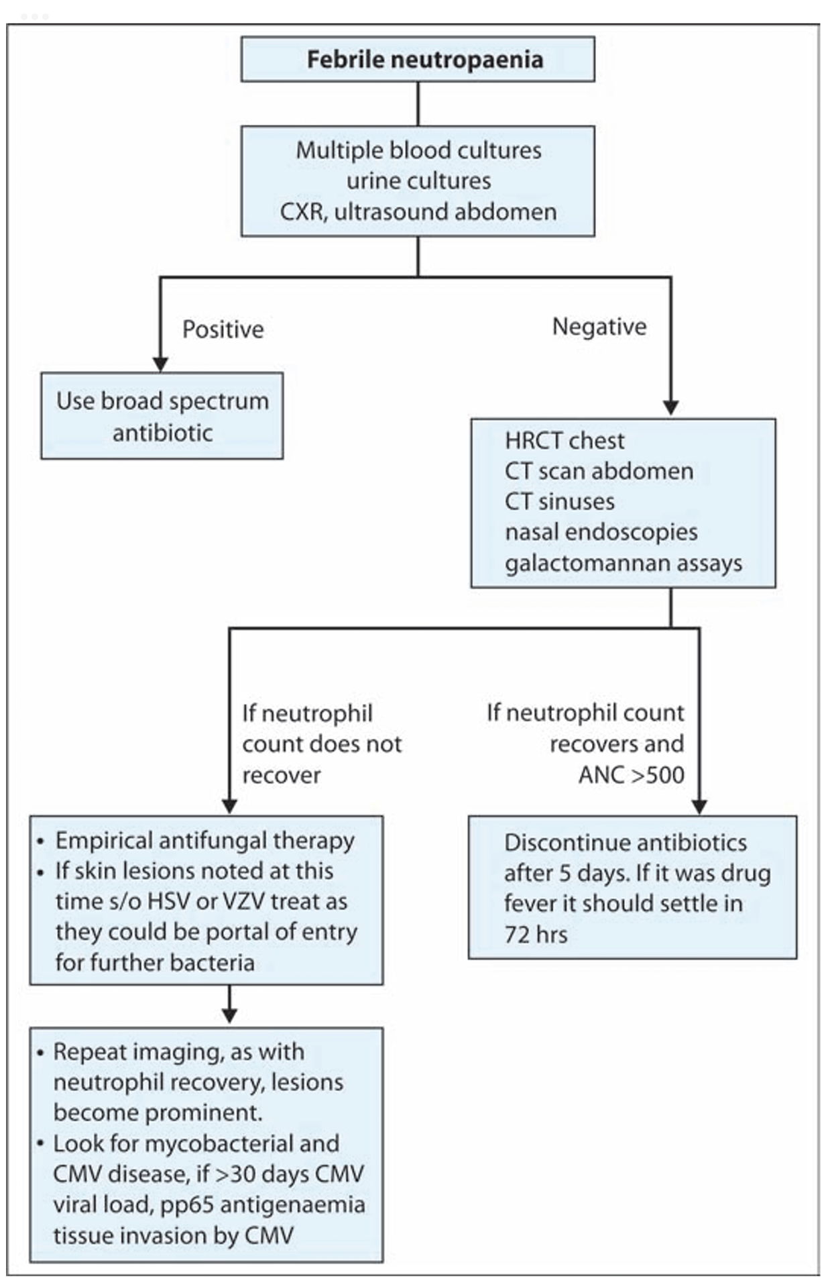

Slide 10
HIV – ASSOCIATED FUO
Same definition + HIV
CD4 Specific infections
Causes
  70% - TB
  10% – Cryptococcosis
  7% - PCP
  2% - CAP
  Others – Amoebic liver abscess, Histoplasmosis, NHL, IRIS

Slide 11
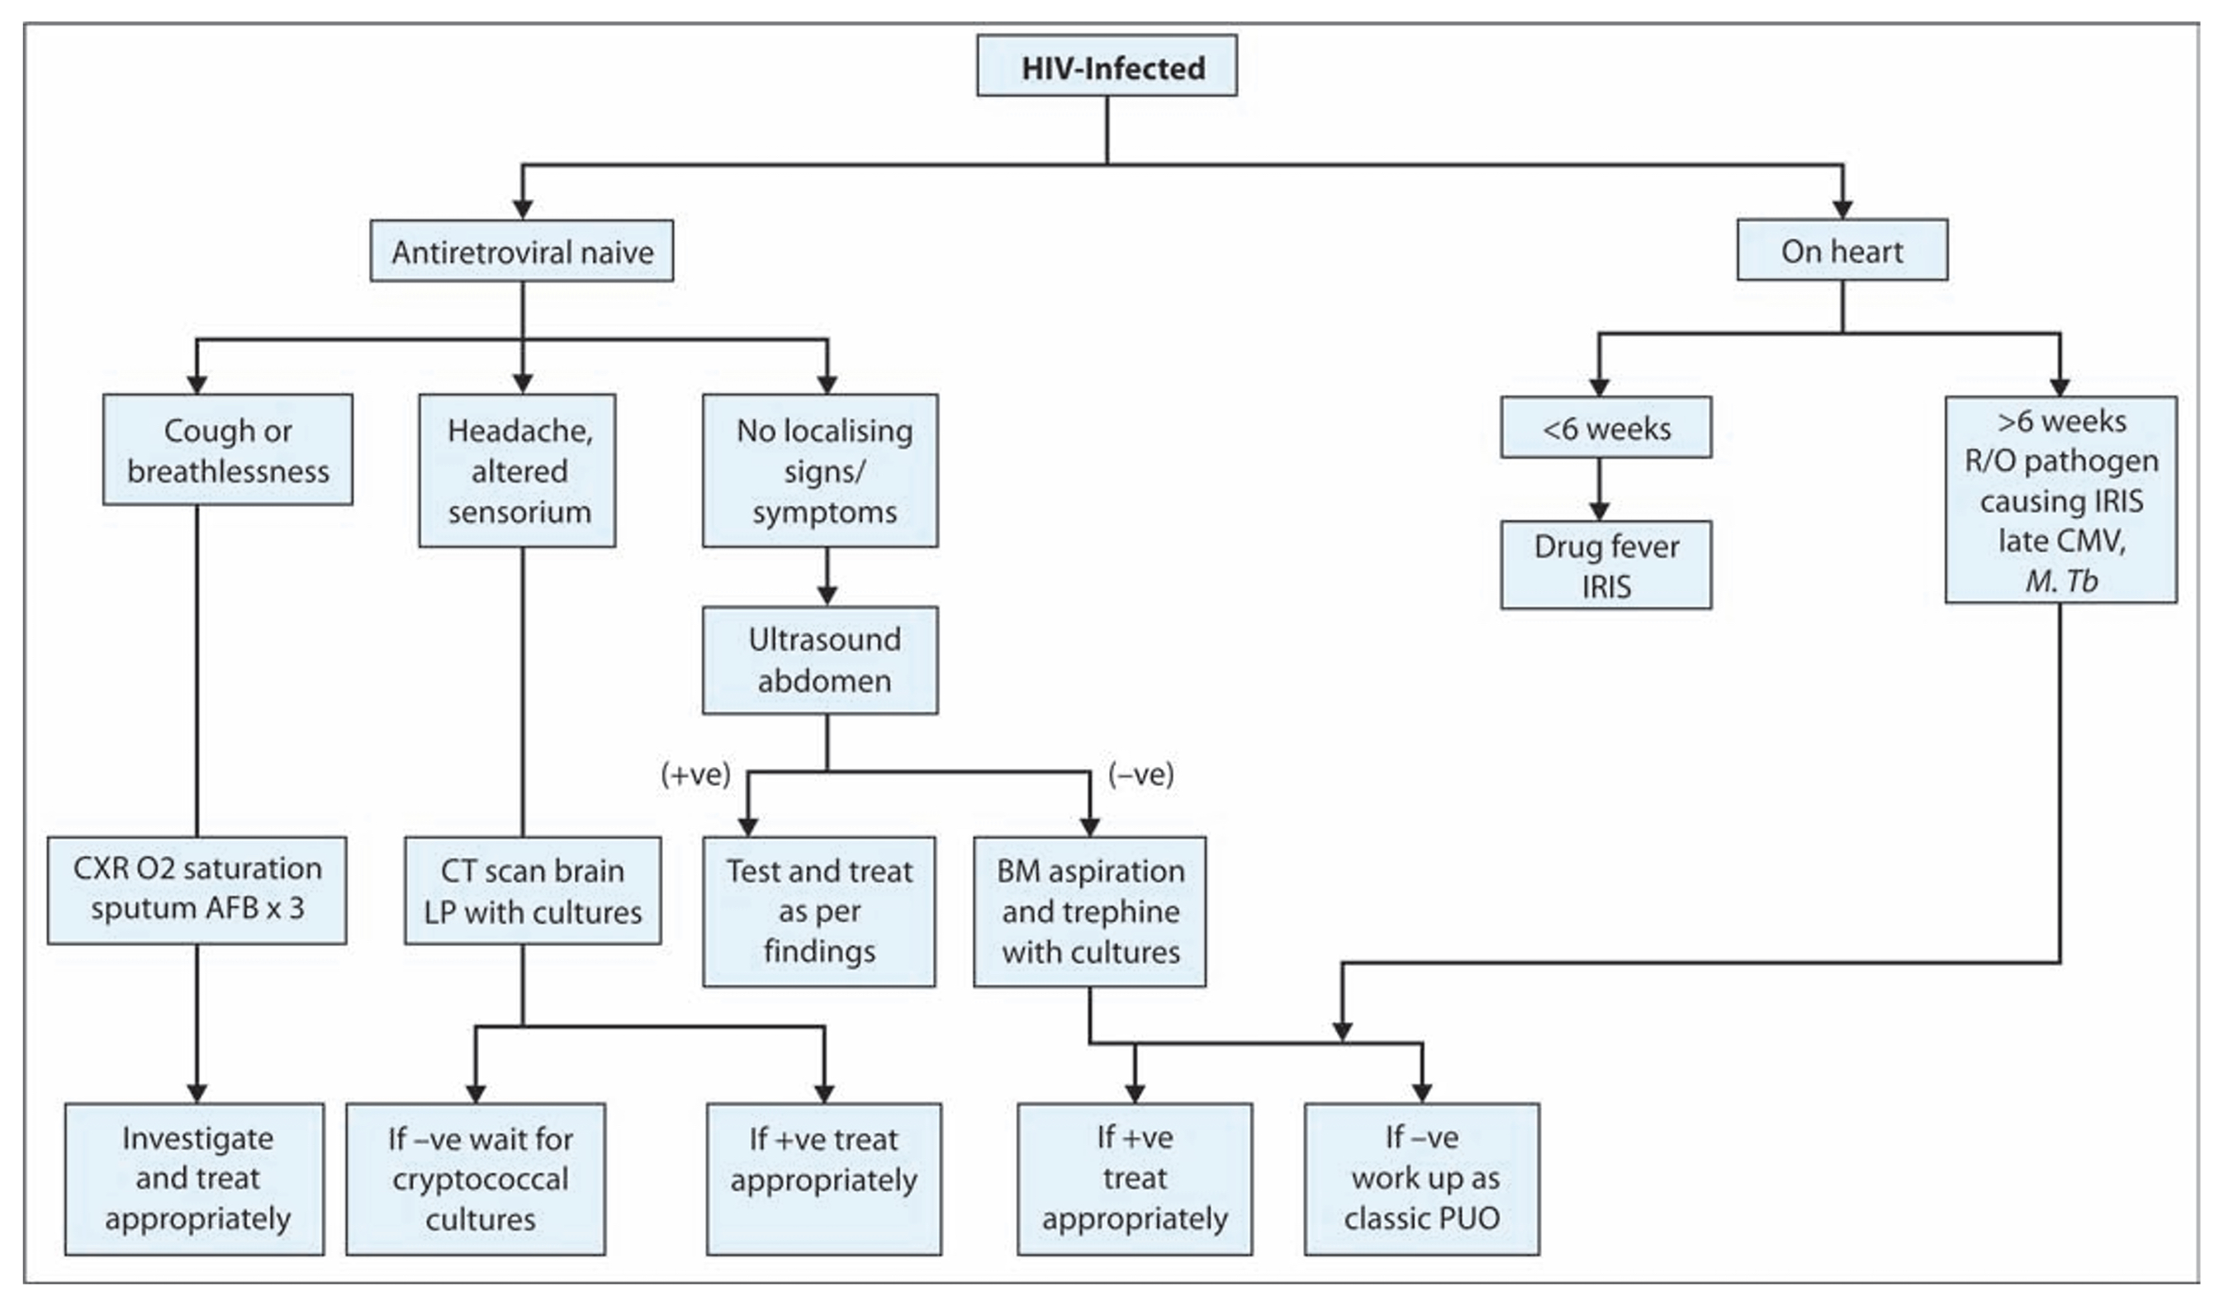

Slide 12
References
Harrison 20th Edition
API Textbook of Medicine 9th Edition

